Slide 1
Comprehensive E-commerce Sales Analysis using SQL

Slide 2
Introduction
This project involves analyzing an e-commerce dataset using SQL to extract valuable insights into customer behavior, sales trends, and product performance. The analysis includes basic to advanced queries, such as calculating total sales per category, identifying customer retention rates, and determining the top customers by spending, offering a thorough understanding of the business dynamics.

Slide 3
Customers
customer_id | customer_unique_id | customer_zip_code_prefix | customer_city | customer_state
06b8999e2fba1a1fbc88172c00ba8bc7 | 861eff4711a542e4b93843c6dd7febb0 | 14409 | franca | SP
18955e83d337fd6b2def6b18a428ac77 | 290c77bc529b7ac935b93aa66c333dc3 | 9790 | sao bernardo do campo | SP
4e7b3e00288586ebd08712fdd0374a03 | 060e732b5b29e8181a18229c7b0b2b5e | 1151 | sao paulo | SP
b2b6027bc5c5109e529d4dc6358b12c3 | 259dac757896d24d7702b9acbbff3f3c | 8775 | mogi das cruzes | SP
4f2d8ab171c80ec8364f7c12e35b23ad | 345ecd01c38d18a9036ed96c73b8d066 | 13056 | campinas | SP
879864dab9bc3047522c92c82e1212b8 | 4c93744516667ad3b8f1fb645a3116a4 | 89254 | jaragua do sul | SC

Slide 4
Geolocation
geolocation_zip_code_prefix | geolocation_lat | geolocation_lng | geolocation_city | geolocation_state
1037 | -23.54562128 | -46.63929205 | sao paulo | SP
1046 | -23.54608113 | -46.6448203 | sao paulo | SP
1046 | -23.54612897 | -46.64295148 | sao paulo | SP
1041 | -23.54439216 | -46.63949931 | sao paulo | SP
1035 | -23.54157796 | -46.64160722 | sao paulo | SP
1012 | -23.5477623 | -46.63536054 | são paulo | SP

Slide 5
Order_items
order_id | order_item_id | product_id | seller_id | shipping_limit_date | price | freight_value
00010242fe8c5a6d1ba2dd792cb16214 | 1 | 4244733e06e7ecb4970a6e2683c13e61 | 48436dade18ac8b2bce089ec2a041202 | 9/19/2017 9:45 | 58.9 | 13.29
00018f77f2f0320c557190d7a144bdd3 | 1 | e5f2d52b802189ee658865ca93d83a8f | dd7ddc04e1b6c2c614352b383efe2d36 | 5/3/2017 11:05 | 239.9 | 19.93
000229ec398224ef6ca0657da4fc703e | 1 | c777355d18b72b67abbeef9df44fd0fd | 5b51032eddd242adc84c38acab88f23d | 1/18/2018 14:48 | 199 | 17.87
00024acbcdf0a6daa1e931b038114c75 | 1 | 7634da152a4610f1595efa32f14722fc | 9d7a1d34a5052409006425275ba1c2b4 | 8/15/2018 10:10 | 12.99 | 12.79
00042b26cf59d7ce69dfabb4e55b4fd9 | 1 | ac6c3623068f30de03045865e4e10089 | df560393f3a51e74553ab94004ba5c87 | 2/13/2017 13:57 | 199.9 | 18.14
00048cc3ae777c65dbb7d2a0634bc1ea | 1 | ef92defde845ab8450f9d70c526ef70f | 6426d21aca402a131fc0a5d0960a3c90 | 5/23/2017 3:55 | 21.9 | 12.69

Slide 6
orders
order_id | customer_id | order_status | order_purchase_timestamp | order_approved_at | order_delivered_carrier_date | order_delivered_customer_date | order_estimated_delivery_date
e481f51cbdc54678b7cc49136f2d6af7 | 9ef432eb6251297304e76186b10a928d | delivered | 10/2/2017 10:56 | 10/2/2017 11:07 | 10/4/2017 19:55 | 10/10/2017 21:25 | 10/18/2017 0:00
53cdb2fc8bc7dce0b6741e2150273451 | b0830fb4747a6c6d20dea0b8c802d7ef | delivered | 7/24/2018 20:41 | 7/26/2018 3:24 | 7/26/2018 14:31 | 8/7/2018 15:27 | 8/13/2018 0:00
47770eb9100c2d0c44946d9cf07ec65d | 41ce2a54c0b03bf3443c3d931a367089 | delivered | 8/8/2018 8:38 | 8/8/2018 8:55 | 8/8/2018 13:50 | 8/17/2018 18:06 | 9/4/2018 0:00
949d5b44dbf5de918fe9c16f97b45f8a | f88197465ea7920adcdbec7375364d82 | delivered | 11/18/2017 19:28 | 11/18/2017 19:45 | 11/22/2017 13:39 | 12/2/2017 0:28 | 12/15/2017 0:00
ad21c59c0840e6cb83a9ceb5573f8159 | 8ab97904e6daea8866dbdbc4fb7aad2c | delivered | 2/13/2018 21:18 | 2/13/2018 22:20 | 2/14/2018 19:46 | 2/16/2018 18:17 | 2/26/2018 0:00
a4591c265e18cb1dcee52889e2d8acc3 | 503740e9ca751ccdda7ba28e9ab8f608 | delivered | 7/9/2017 21:57 | 7/9/2017 22:10 | 7/11/2017 14:58 | 7/26/2017 10:57 | 8/1/2017 0:00

Slide 7
payment
order_id | payment_sequential | payment_type | payment_installments | payment_value
b81ef226f3fe1789b1e8b2acac839d17 | 1 | credit_card | 8 | 99.33
a9810da82917af2d9aefd1278f1dcfa0 | 1 | credit_card | 1 | 24.39
25e8ea4e93396b6fa0d3dd708e76c1bd | 1 | credit_card | 1 | 65.71
ba78997921bbcdc1373bb41e913ab953 | 1 | credit_card | 8 | 107.78
42fdf880ba16b47b59251dd489d4441a | 1 | credit_card | 2 | 128.45
298fcdf1f73eb413e4d26d01b25bc1cd | 1 | credit_card | 2 | 96.12

Slide 8
Product
product_id | product category | product_name_length | product_description_length | product_photos_qty | product_weight_g | product_length_cm | product_height_cm | product_width_cm
1e9e8ef04dbcff4541ed26657ea517e5 | perfumery | 40 | 287 | 1 | 225 | 16 | 10 | 14
3aa071139cb16b67ca9e5dea641aaa2f | Art | 44 | 276 | 1 | 1000 | 30 | 18 | 20
96bd76ec8810374ed1b65e291975717f | sport leisure | 46 | 250 | 1 | 154 | 18 | 9 | 15
cef67bcfe19066a932b7673e239eb23d | babies | 27 | 261 | 1 | 371 | 26 | 4 | 26
9dc1a7de274444849c219cff195d0b71 | housewares | 37 | 402 | 4 | 625 | 20 | 17 | 13
41d3672d4792049fa1779bb35283ed13 | musical instruments | 60 | 745 | 1 | 200 | 38 | 5 | 11

Slide 9
Sellere
order_id | customer_id | order_status | order_purchase_timestamp | order_approved_at | order_delivered_carrier_date | order_delivered_customer_date | order_estimated_delivery_date
e481f51cbdc54678b7cc49136f2d6af7 | 9ef432eb6251297304e76186b10a928d | delivered | 10/2/2017 10:56 | 10/2/2017 11:07 | 10/4/2017 19:55 | 10/10/2017 21:25 | 10/18/2017 0:00
53cdb2fc8bc7dce0b6741e2150273451 | b0830fb4747a6c6d20dea0b8c802d7ef | delivered | 7/24/2018 20:41 | 7/26/2018 3:24 | 7/26/2018 14:31 | 8/7/2018 15:27 | 8/13/2018 0:00
47770eb9100c2d0c44946d9cf07ec65d | 41ce2a54c0b03bf3443c3d931a367089 | delivered | 8/8/2018 8:38 | 8/8/2018 8:55 | 8/8/2018 13:50 | 8/17/2018 18:06 | 9/4/2018 0:00
949d5b44dbf5de918fe9c16f97b45f8a | f88197465ea7920adcdbec7375364d82 | delivered | 11/18/2017 19:28 | 11/18/2017 19:45 | 11/22/2017 13:39 | 12/2/2017 0:28 | 12/15/2017 0:00
ad21c59c0840e6cb83a9ceb5573f8159 | 8ab97904e6daea8866dbdbc4fb7aad2c | delivered | 2/13/2018 21:18 | 2/13/2018 22:20 | 2/14/2018 19:46 | 2/16/2018 18:17 | 2/26/2018 0:00
a4591c265e18cb1dcee52889e2d8acc3 | 503740e9ca751ccdda7ba28e9ab8f608 | delivered | 7/9/2017 21:57 | 7/9/2017 22:10 | 7/11/2017 14:58 | 7/26/2017 10:57 | 8/1/2017 0:00

Slide 10
PYTHON TO SQL
# Generate the CREATE TABLE statement with appropriate data types
columns = ', '.join([f'`{col}` {get_sql_type(df[col].dtype)}' for col in df.columns])
create_table_query = f'CREATE TABLE IF NOT EXISTS `{table_name}` ({columns})'
cursor.execute(create_table_query)
# Insert DataFrame data into the MySQL table
for _, row in df.iterrows():
# Convert row to tuple and handle NaN/None explicitly
values = tuple(None if pd.isna(x) else x for x in row)
sql = f"INSERT INTO `{table_name}` ({', '.join(['`' + col + '`' for col in df.columns])}) VALUES ({', '.join(['%s'] * len(row))})"
cursor.execute(sql, values)
# Commit the transaction for the current CSV file
conn.commit()
# Close the connection
conn.close()
pip install pandas
pip install mysql-connector-python
pip install matplotlib
pip install seaborn
cursor = conn.cursor()
def get_sql_type(dtype):
if pd.api.types.is_integer_dtype(dtype):
return 'INT'
elif pd.api.types.is_float_dtype(dtype):
return 'FLOAT'
elif pd.api.types.is_bool_dtype(dtype):
return 'BOOLEAN'
elif pd.api.types.is_datetime64_any_dtype(dtype):
return 'DATETIME'
else:
return 'TEXT'
for csv_file, table_name in csv_files:
file_path = os.path.join(folder_path, csv_file)
# Read the CSV file into a pandas DataFrame
df = pd.read_csv(file_path)
# Replace NaN with None to handle SQL NULL
df = df.where(pd.notnull(df), None)
# Debugging: Check for NaN values
print(f"Processing {csv_file}")
print(f"NaN values before replacement:\n{df.isnull().sum()}\n")
# Clean column names
df.columns = [col.replace(' ', '_').replace('-', '_').replace('.', '_') for col in df.columns]
import pandas as pd
import mysql.connector
import os
# List of CSV files and their corresponding table names
csv_files = [
('customers.csv', 'customers'),
('orders.csv', 'orders'),
('sellers.csv', 'sellers'),
('products.csv', 'products'),
('geolocation.csv', 'geolocation'),
('payments.csv', 'payments'),
('order_items.csv', 'order_items')# Added payments.csv for specific handling
]
# Connect to the MySQL database
conn = mysql.connector.connect(
host='localhost',
user='root',
password='Ali242.@com',
database='E_Commerce_Sales_Dataset'
)
cursor = conn.cursor()
# Folder containing the CSV files
folder_path = 'C:/Users/hst/Desktop/Data analytics/sql+python project'

Slide 11
Lets Solve Queries
import pandas as pd
import matplotlib.pyplot as plt
import seaborn as sns
import mysql.connector
# Connect to the MySQL database
conn = mysql.connector.connect(
host='localhost',
user='root',
password='Ali242.@com',
database='E_Commerce_Sales_Dataset'
)
# activate cursor in database
cursor = conn.cursor()

Slide 12
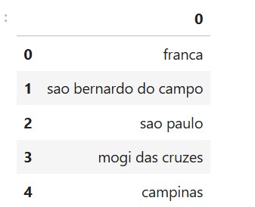
1. List all unique cities where customers are located.
# query= sql code
query = """ select distinct customer_city from customers """
#execute the query
cursor.execute(query)
#to show dat here from sql
data = cursor.fetchall()
df = pd.DataFrame(data)
df.head()

Slide 13
2. Count the number of orders placed in 2017.
# query= sql code
query = """ select count(order_id) from orders where year(order_purchase_timestamp)=2017 """
#execute the query
cursor.execute(query)
#to show dat here from sql
data = cursor.fetchall()
data #[(45101,)]
data[0] #(45101,)
data[0][0] #45101
"Total porder placed in 2017 are", data[0][0]

Slide 14
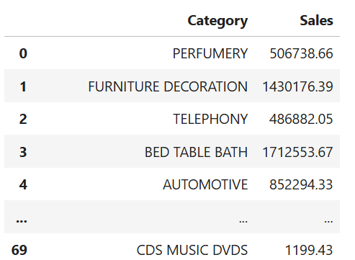
3. Find the total sales per category.
import pandas as pd
import matplotlib.pyplot as plt
import seaborn as sns
import mysql.connector
# Connect to the MySQL database
conn = mysql.connector.connect(
host='localhost',
user='root',
password='Ali242.@com',
database='E_Commerce_Sales_Dataset'
)
# activate cursor in database
cursor = conn.cursor()

Slide 15

4. Calculate the percentage of orders that were paid in installments.
query = """ select ((sum(case when payment_installments >= 1 then 1
else 0 end))/count(*))*100
from payments
"""
cursor.execute(query)
data = cursor.fetchall()
"the percentage of orders that were paid in installments is", data[0][0]

Slide 16
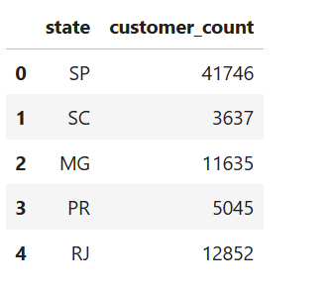
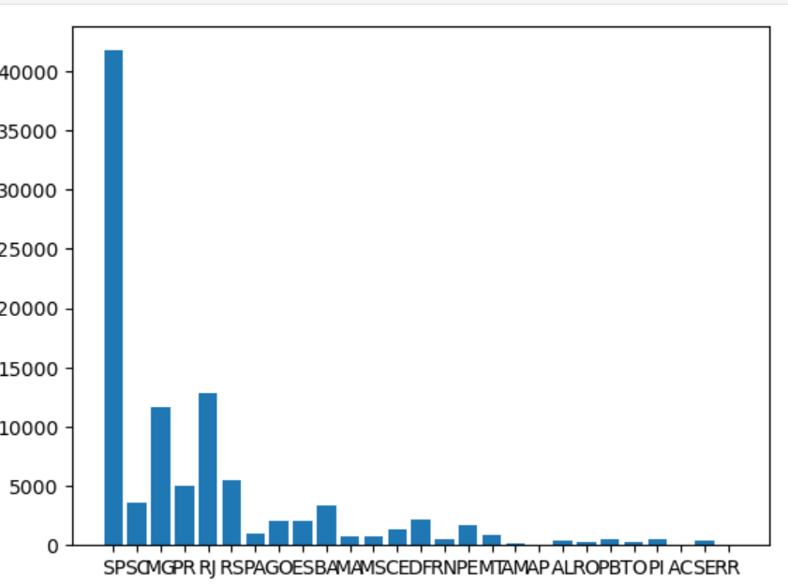
5. Count the number of customers from each state.
query = """ select customer_state ,count(customer_id)
from customers group by customer_state
"""
cursor.execute(query)
data = cursor.fetchall()
df = pd.DataFrame(data, columns = ["state", "customer_count" ])
df.head()
#bar plot
plt.bar(df["state"], df["customer_count"])
plt.show()

Slide 17
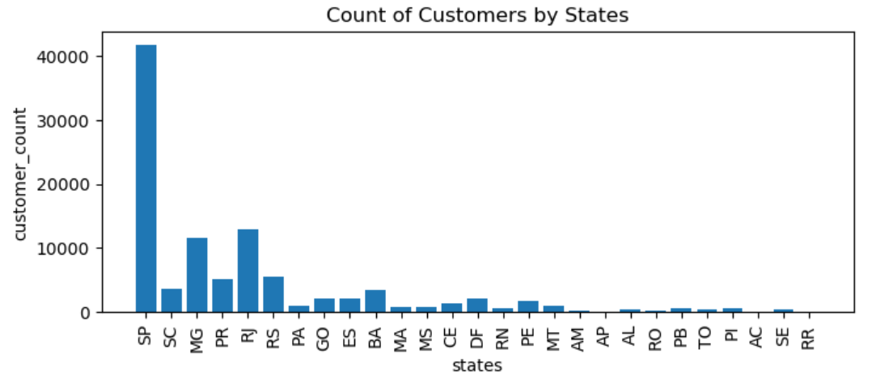
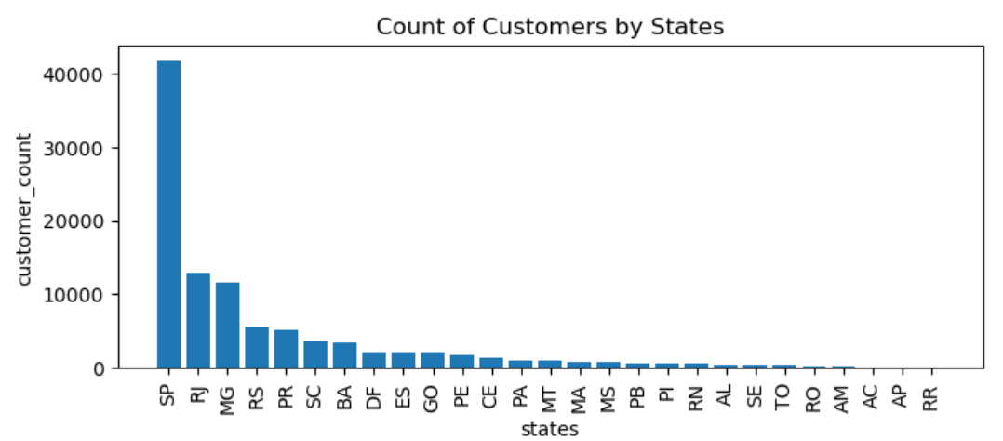
Adjust the BAR plot
plt.figure(figsize = (8,3))
plt.bar(df["state"], df["customer_count"])
plt.xticks(rotation = 90)
plt.xlabel("states")
plt.ylabel("customer_count")
plt.title("Count of Customers by States")
plt.show()
df = df.sort_values(by = "customer_count", ascending= False)
plt.figure(figsize = (8,3))
plt.bar(df["state"], df["customer_count"])
plt.xticks(rotation = 90)
plt.xlabel("states")
plt.ylabel("customer_count")
plt.title("Count of Customers by States")
plt.show()

Slide 18
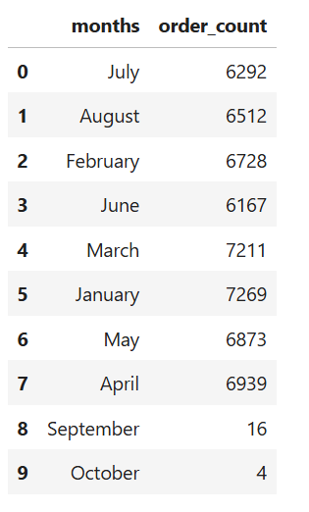
6. Calculate the number of orders per month in 2018.
query = """ select monthname(order_purchase_timestamp) months, count(order_id) order_count
from orders where year(order_purchase_timestamp) = 2018
group by months
"""
cursor.execute(query)
data = cursor.fetchall()
df = pd.DataFrame(data, columns = ["months", "order_count"])
df

Slide 19
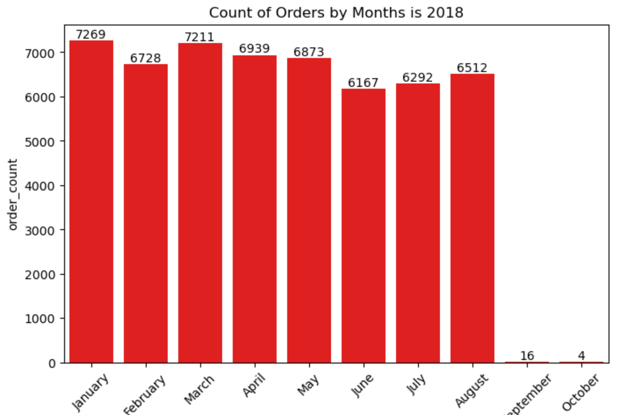
SNS PLOT
o = ["January", "February","March","April","May","June","July","August","September","October"]
#by seaborn
plt.figure(figsize = (8,5))
ax = sns.barplot(x = df["months"],y = df["order_count"], data = df, order = o, color = "red")
plt.xticks(rotation = 45)
ax.bar_label(ax.containers[0])
plt.title("Count of Orders by Months is 2018")
plt.show()

Slide 20
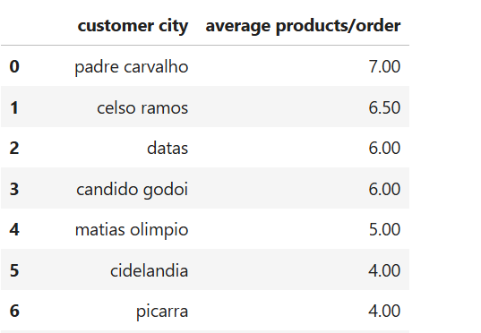
7. Find the average number of products per order, grouped by customer city.
query = """with count_per_order as
(select orders.order_id, orders.customer_id, count(order_items.order_id) as oc
from orders join order_items
on orders.order_id = order_items.order_id
group by orders.order_id, orders.customer_id)
select customers.customer_city, round(avg(count_per_order.oc),2) average_orders
from customers join count_per_order
on customers.customer_id = count_per_order.customer_id
group by customers.customer_city order by average_orders desc
"""
cursor.execute(query)
data = cursor.fetchall()
df = pd.DataFrame(data,columns = ["customer city", "average products/order"])
df.head(10)

Slide 21
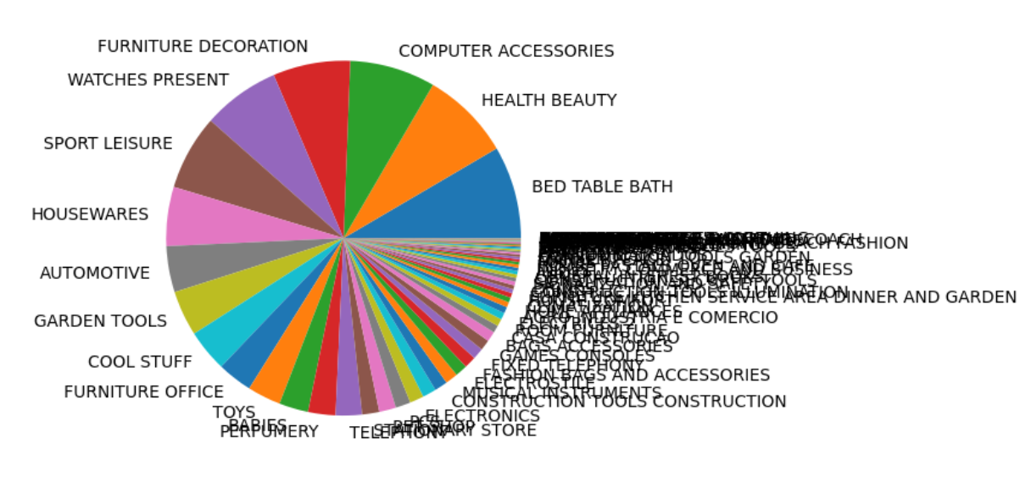
8. Calculate the percentage of total revenue contributed by each product category.
query = """select upper(products.product_category) category, (sum(payments.payment_value)/(select sum(payment_value)
from payments))*100 Per_Sales
from products join order_items
on products.product_id = order_items.product_id
join payments
on payments.order_id = order_items.order_id
group by category
order by Per_Sales desc;
"""
cursor.execute(query)
data = cursor.fetchall()
df = pd.DataFrame(data,columns = ["category", "Per_Sales"])
df.head(5)
#pie chart
plt.pie(df["Per_Sales"],labels=df["category"])
plt.show

Slide 22
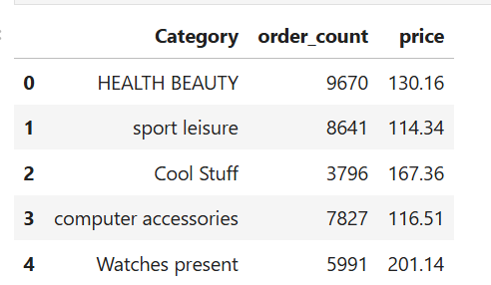


9. Identify the correlation between product price and the number of times a product has been purchased.
import numpy as np
query = """select products.product_category, count(order_items.product_id),
round(avg(order_items.price),2)
from products join order_items
on products.product_id = order_items.product_id
group by products.product_category"""
cursor.execute(query)
data = cursor.fetchall()
df = pd.DataFrame(data,columns = ["Category", "order_count","price"])
df.head(5)
# coorelation
arr1 = df["order_count"]
arr2 = df["price"]
np.corrcoef([arr1,arr2])
a = np.corrcoef([arr1,arr2])
print("the correlation is", a[0][-1])

Slide 23
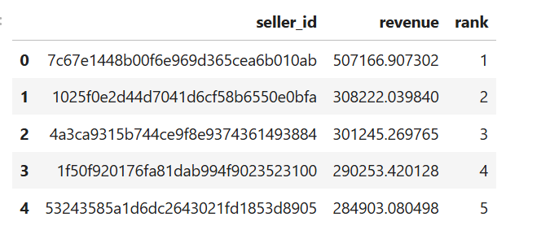
5. Calculate the total revenue generated by each seller, and rank them by revenue.
query = """ select *,
dense_rank() over(order by revenue desc) as rn
from
(select order_items.seller_id, sum(payments.payment_value)
revenue from order_items join payments
on order_items.order_id = payments.order_id
group by order_items.seller_id) as a """
cursor.execute(query)
data = cursor.fetchall()
df = pd.DataFrame(data, columns = ["seller_id", "revenue", "rank"])
df.head(5)

Slide 24
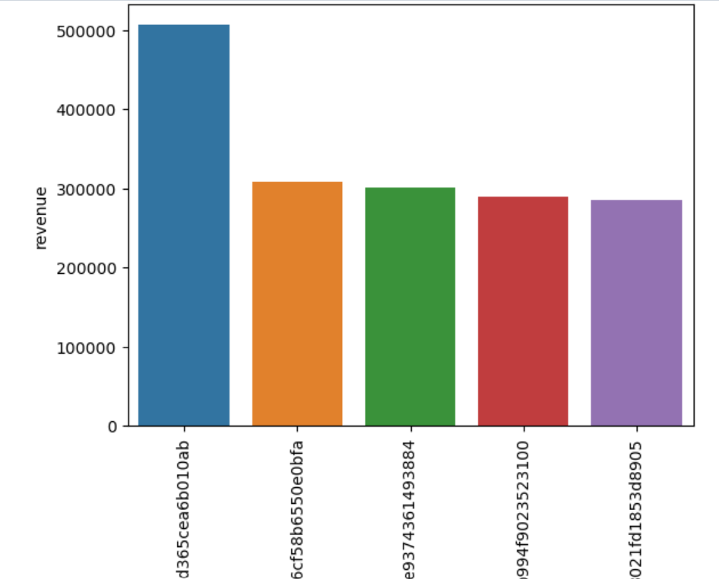
BAR PLOT
query = """ select *, dense_rank() over(order by revenue desc) as rn from
(select order_items.seller_id, sum(payments.payment_value)
revenue from order_items join payments
on order_items.order_id = payments.order_id
group by order_items.seller_id) as a """
cursor.execute(query)
data = cursor.fetchall()
df = pd.DataFrame(data, columns = ["seller_id", "revenue", "rank"])
df = df.head()
sns.barplot(x = "seller_id", y = "revenue", data = df)
plt.xticks(rotation = 90)
plt.show()

Slide 25
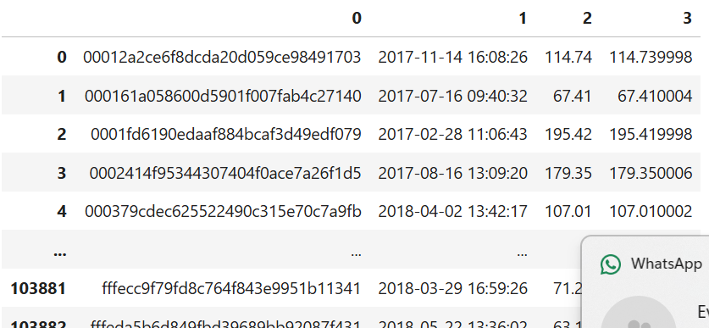
11. Calculate the moving average of order values for each customer over their order history.
query = """ select *,
dense_rank() over(order by revenue desc) as rn
from
(select order_items.seller_id, sum(payments.payment_value)
revenue from order_items join payments
on order_items.order_id = payments.order_id
group by order_items.seller_id) as a """
cursor.execute(query)
data = cursor.fetchall()
df = pd.DataFrame(data, columns = ["seller_id", "revenue", "rank"])
df.head(5)

Slide 26
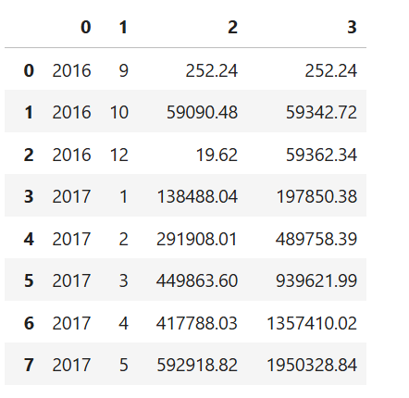
12. Calculate the cumulative sales per month for each year.
query = """select years, months , payment, sum(payment)
over(order by years, months) cumulative_sales from
(select year(orders.order_purchase_timestamp) as years,
month(orders.order_purchase_timestamp) as months,
round(sum(payments.payment_value),2) as payment from orders join payments
on orders.order_id = payments.order_id
group by years, months order by years, months) as a
"""
cursor.execute(query)
data = cursor.fetchall()
df = pd.DataFrame(data)
df

Slide 27
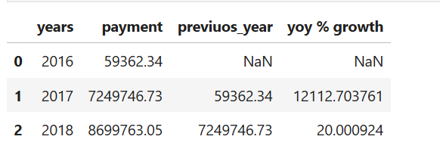
13. Calculate the year-over-year growth rate of total sales.
query = """with a as(select year(orders.order_purchase_timestamp) as years,
round(sum(payments.payment_value),2) as payment from orders join payments
on orders.order_id = payments.order_id
group by years order by years)
select years,payment,lag(payment, 1) over(order by years) previuos_year,
((payment - lag(payment, 1) over(order by years))/lag(payment, 1) over(order by years)) * 100 from a"""
cursor.execute(query)
data = cursor.fetchall()
df = pd.DataFrame(data, columns = ["years","payment","previuos_year", "yoy % growth"])
df

Slide 28

14. Calculate the retention rate of customers, defined as the percentage of customers who make another purchase within 6 months of their first purchase.
query = """with a as (select customers.customer_id,
min(orders.order_purchase_timestamp) first_order
from customers join orders
on customers.customer_id = orders.customer_id
group by customers.customer_id),
b as (select a.customer_id, count(distinct orders.order_purchase_timestamp) next_order
from a join orders
on orders.customer_id = a.customer_id
and orders.order_purchase_timestamp > first_order
and orders.order_purchase_timestamp <
date_add(first_order, interval 6 month)
group by a.customer_id)
select 100 * (count( distinct a.customer_id)/ count(distinct b.customer_id))
from a left join b
on a.customer_id = b.customer_id ;"""
cursor.execute(query)
data = cursor.fetchall()
data

Slide 29
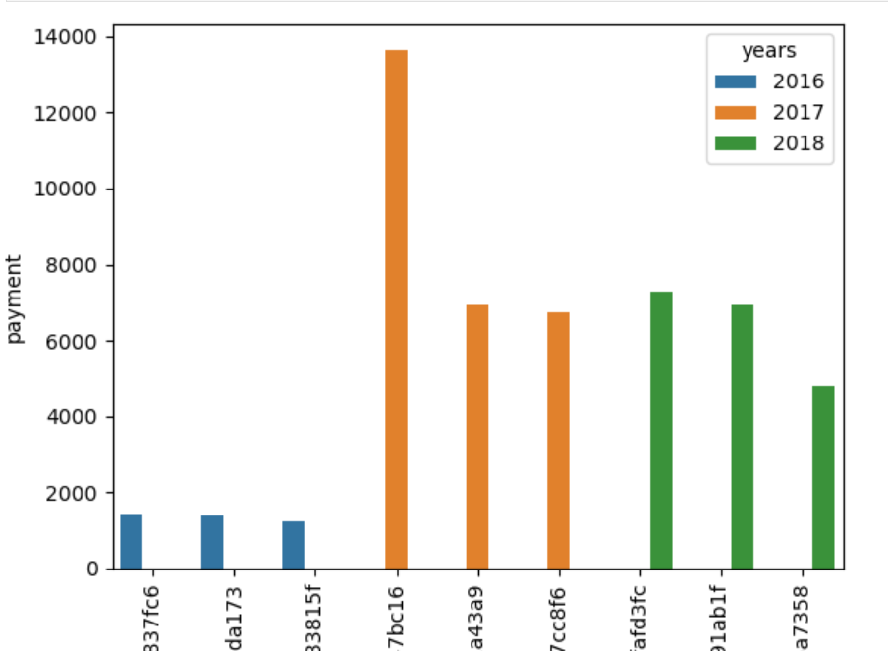
15. Identify the top 3 customers who spent the most money in each year.
query = """select years, customer_id, payment, d_rank
from
(select year(orders.order_purchase_timestamp) years,
orders.customer_id,
sum(payments.payment_value) payment,
dense_rank() over(partition by year(orders.order_purchase_timestamp)
order by sum(payments.payment_value) desc) d_rank
from orders join payments
on payments.order_id = orders.order_id
group by year(orders.order_purchase_timestamp),
orders.customer_id) as a
where d_rank <= 3 ;"""
cursor.execute(query)
data = cursor.fetchall()
df = pd.DataFrame(data, columns = ["years","id","payment","rank"])
df
df['years'] = df['years'].astype(str)
sns.barplot(x = "id", y = "payment", data = df, hue = "years")
plt.xticks(rotation = 90)
plt.show()

